Slide 1
Data Frames
B . Jyothi
Assistant Professor
Department of Computer Science & Engineering,
Anurag University

Slide 2
Data Frame
R refers to datasets as data frames
DataFrames are generic data objects of R which are used to store the tabular data. Data frames are considered to be the most popular data objects in R programming because it is more comfortable to analyze the data in the tabular form.
A data frame is a two-dimensional array-like structure or a table in which a column contains values of one variable, and rows contains one set of values from each column.
A data frame is a special case of the list in which each component has equal length.

Slide 3
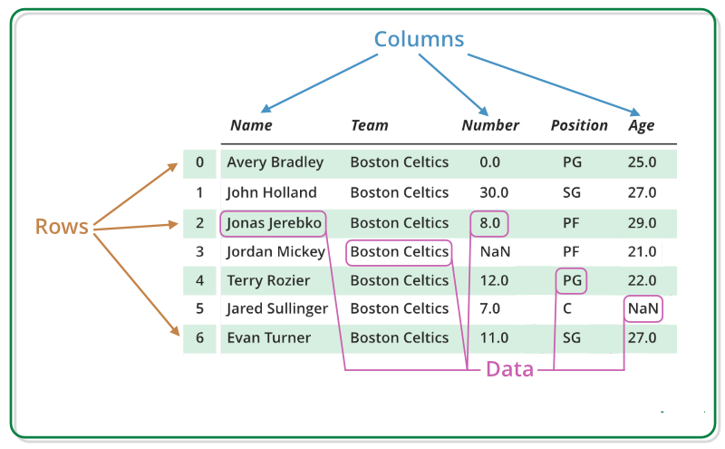
Data Frame are made up of three principal components, the data, rows, and columns.

Slide 4
characteristics of a data frame
The column names should be non-empty.
The row names should be unique.
The data stored in a data frame can be of numeric, factor or character type.
Each column should contain same number of data items.

Slide 5
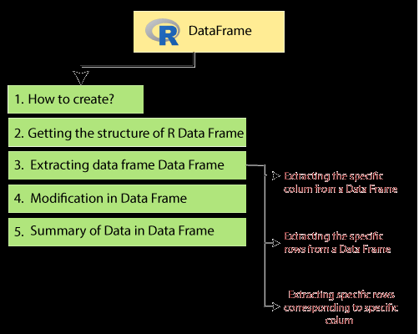

Slide 6
How to create Data Frame
In R, the data frames are created with the help of data.frame() function.
This function contains the vectors of any type such as numeric, character, or integer.
# Creating the data frame.
emp.data<- data.frame(
employee_id = 1:5,
employee_name = c("Shubham","Arpita","Nishka","Gunjan","Sumit"),
sal = c(623.3,915.2,611.0,729.0,843.25),
starting_date = as.Date(c("2012-01-01", "2013-09-23", "2014-11-15", "2014-05-11","2015-03-27")), stringsAsFactors = FALSE )
# Printing the data frame.
print(emp.data)

Slide 7
data() # To see a list of built-in datasets
head(data frame _ name) # Print the first few rows of a dataset/matrix
tail(data frame _ name) # Print the last few rows of a dataset/matrix
names(data frame_name) # Column names
colnames (data frame _ name) # Column and row names
rownames (data frame _ name)
dim(data frame _ name) # Dimension of the dataframe
str(data frame _ name) # returns the data with its complete structure.
as.data.frame(matrix name) # convert a matrix to a data frame

Slide 8
summary(data frame _ name) #to extract the statistical summary and nature of the data
attributes(data frame _ name)

Slide 9
Getting the structure of R Data Frame
Str(emp.data)
Output:
'data.frame': 5 obs. of 4 variables:
$ employee_id : int 1 2 3 4 5
$ employee_name: chr "Shubham" "Arpita" "Nishka" "Gunjan" ...
$ sal : num 623 515 611 729 843
$ starting_date: Date, format: "2012-01-01" "2013-09-23" ...

Slide 10
How to access Components of a Data Frame
Components of data frame can be accessed like a list or like a matrix.
We can use either [, [[ or $ operator to access columns of data frame.
Ex:
df ["col1"]
df$col1
df[[“col1”]]
Indexing with [ will return us a data frame but the other two will reduce it into a vector.
To avoid this you can introduce the drop = FALSE argument:

Slide 11
Extracting data from Data Frame
We can extract the data in three ways which are as follows:
We can extract the specific columns from a data frame using the column name.
Syntax: dataframe_name $ column name
Ex:
emp.data$employee_id
emp.data$sal

Slide 12
We can extract the specific rows also from a data frame.
# Extracting first row from a data frame
emp.data[1,]
# Extracting last two row from a data frame
emp.data[4:5,]

Slide 13
Extracting specific rows corresponding to specific columns
We can extract the specific rows corresponding to specific columns.
Ex:
# Extracting 2nd and 3rd row corresponding to the 1st and 4th column
emp.data[c(2,3),c(1,4)]

Slide 14
We can also also change the existing column names by using colnames() or names()
# add/change column names with colnames()
Ex: colnames(df) <- c("col_1", "col_2", "col_3", "col_4")
names(df) <- c("col.1", "col.2", "col.3", "col.4")
We can row names to data frame with rownames()
Ex: rownames(df) <- c("row1", "row2", "row3")
we can add a comment to a data frame without affecting how it operates.
# adding a comment attribute
comment(df) <- "adding a comment to a data frame"

Slide 15
Expand R Data Frame
A data frame can be expanded by adding columns and rows.
Add Column
Add the column vector using a new column name.
Ex:
df$marks=c(80,90,100)
employee_data$dept <- c("IT","Finance","Operations","HR","Administration")

Slide 16
Modification in Data Frame
R allows us to do modification in our data frame. Like matrices modification, we can modify our data frame through re-assignment. We cannot only add rows and columns, but also we can delete them. The data frame is expanded by adding rows and columns.
We can
Add a column by adding a column vector with the help of a new column name using cbind() function.
Add rows by adding new rows in the same structure as the existing data frame and using rbind() function
Delete the columns by assigning a NULL value to them.
Delete the rows by re-assignment to them.

Slide 17
Adding rows and columns to the data frame
Adding extra rows: We can add extra row using the command rbind().
syntax :
newDF = rbind(df, the entries for the new row you have to add )
df = Original data frame
Adding extra columns: We can add extra column using the command cbind().
syntax :
newDF = cbind(df, the entries for the new column you have to add )
df = Original data frame

Slide 18
Example
df = data.frame(
"Name" = c("Amiya", "Raj", "Asish"),
"Language" = c("R", "Python", "Java"),
"Age" = c(22, 25, 45)
)
# Add a new column using cbind()
newDf = cbind(df, Rank=c(3, 5, 1))
# Add a new row using rbind()
newDf = rbind(df, data.frame(Name = "Sandeep",
Language = "C",
Age = 23
))
print(newDf)

Slide 19
Deleting rows and columns from a data frame
To delete a row or a column, first of all, you need to access that row or column and then insert a negative sign before that row or column. It indicates that you had to delete that row or column.
Syntax:
newDF = df[-rowNo, -colNo]
df = original data frame
#Delete rows from data frame
emp.data<-emp.data[-1,]
print(emp.data)
#Delete column from the data frame
emp.data$starting_date<-NULL
print(emp.data)

Slide 20
Editing dataframes
edit() command:
mytable=data.frame()
mytable=edit(mytable)

Slide 21
Subset a Data Frame
We use the subset() function.
Syntax:
subset(x, condition)
arguments: -
x: data frame used to perform the subset
condition: define the conditional statement

Slide 22
# using brackets
mtcars[mtcars$mpg > 20 & mtcars$cyl == 6, ]
# using the simplified subset function
subset(mtcars, mpg > 20 & cyl == 6)

Slide 23
sorting
Order()
Assignment

Slide 24


Quote of the day..
What we think, we become.
Gautama Buddha, Sege

Slide 25

Today’s discussion…
R is an open source programming language and software environment for statistical computing and graphics.
The R language is widely used among statisticians and data miners for developing statistical software and data analytics tools

Slide 26
History of R
Modelled after S & S-plus, developed at AT&T labs in late 1980s.
R project was started by Robert Gentleman and Ross Ihaka Department of Statistics, University of Auckland (1995).
Currently maintained by R core development team – an international team of volunteer developers (since 1997).

Slide 27
R resources
http://www.r-project.org/
http://cran.r-project.org/doc/contrib/Verzani-SimpleR.pdf

Slide 28
Download R and RStudio
Download R :
http://cran.r-project.org/bin/
Download RStudio :
http://www.rstudio.com/ide/download/desktop

Slide 29
Installation
Installing R on windows PC :
Use internet browser to point to : http://mirror.aarnet.edu.au/pub/CRAN
Under the heading Precompiled Binary Distributions, choose the link Windows.
Next heading is R for Windows; choose the link base.
Click on download option(R 3.4.1 for windows).
Save this to the folder C:\R on your PC.
When downloading is complete, close or minimize the Internet browser.
Double click on R 3.4.1-win32.exe in C:\R to install.
Installing R on Linux:
sudo apt-get install r-base-core

Slide 30
Installation
Installing RStudio:
Go to www.rstudio.com and click on the "Download RStudio" button.
Click on "Download RStudio Desktop.“
Click on the version recommended for your system, or the latest Windows version, and save the executable file. Run the .exe file and follow the installation instructions.

Slide 31
Version
Get R version
R.Version()
Get RStudio version
RStudio: Toolbar at top > Help > About RStudio

Slide 32
A test run with R in Windows
Double click the R icon on the Desktop and the R Console will open.
Wait while the program loads. You observe something like this.
You can type your own program at the prompt line >.

Slide 33
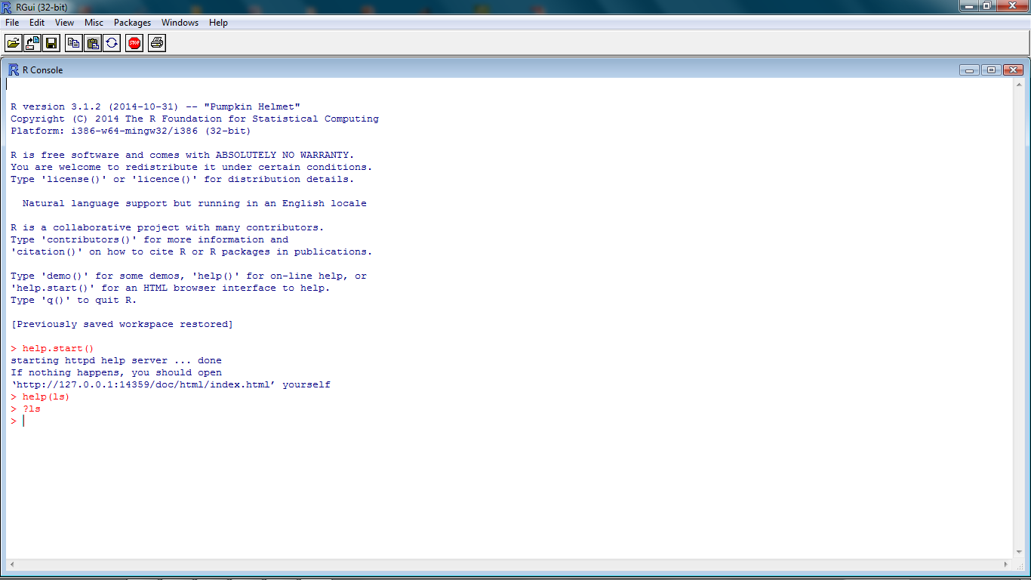
Getting help from R console
help.start()
help(topic)
?topic
??topic

Slide 34
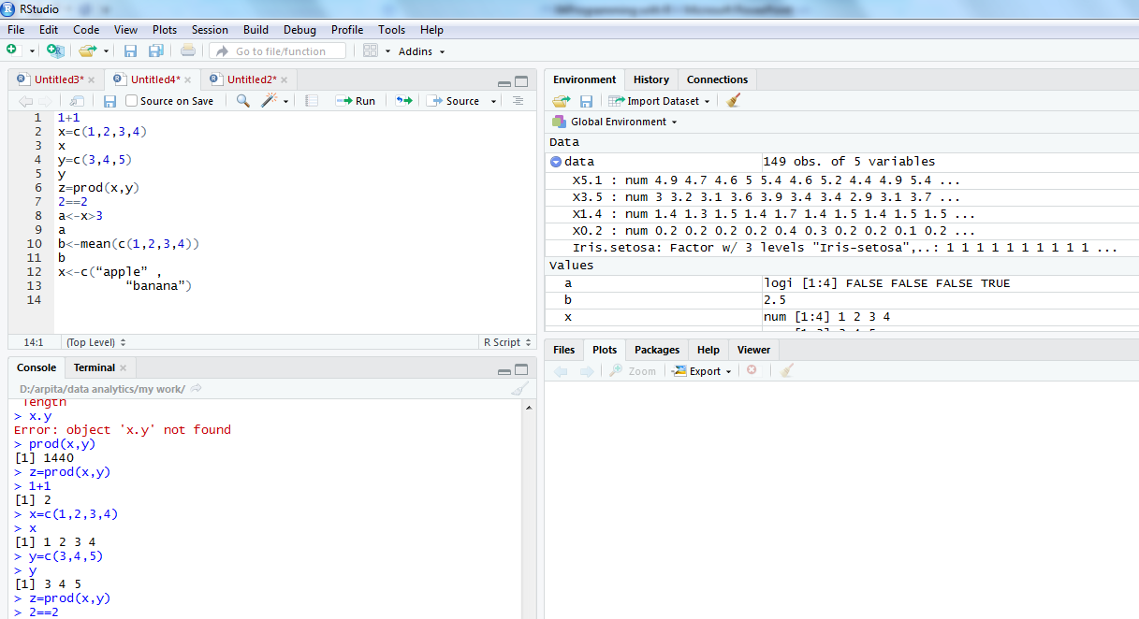
R command in integrated environment

Slide 35
How to use R for simple maths
> 3+5
> 12 + 3 / 4 – 5 + 3*8
> (12 + 3 / 4 – 5) + 3*8
> pi * 2^3 – sqrt(4)
>factorial(4)
>log(2,10)
>log(2, base=10)
>log10(2)
>log(2)
Note
R ignores spaces

Slide 36
How to store results of calculations for future use
> x = 3+5
> x
> y = 12 + 3 / 4 – 5 + 3*8
> y
> z = (12 + 3 / 4 – 5) + 3*8
> z
> A <- 6 + 8 ## no space should be between < & -
> a ## Note: R is case sensitive
>A

Slide 37
Identifiers naming
Don't use underscores ( _ ) or hyphens ( - ) in identifiers.
The preferred form for variable names is all lower case letters and words separated with dots (variable.name) but variableName is also accepted.
Examples: avg.clicks GOOD avgClicks OK avg_Clicks BAD
Function names have initial capital letters and no dots (e.g., FunctionName).

Slide 38
Using C command
> data1 = c(3, 6, 9, 12, 78, 34, 5, 7, 7) ## numerical data
> data1.text = c(‘Mon’, ‘Tue’, “Wed”) ## Text data
## Single or double quote both ok
##copy/paste into R console may not work
> data1.text = c(data1.text, ‘Thu’, ‘Fri’)

Slide 39
Scan command for making data
> data3 = scan() ## data separated by Space / Press
## Press Enter key twice to exit
1: 4 5 7 8
5: 2 9 4
8: 3
9:
> data3
[1] 4 5 7 8 2 9 4 3
## Read 8 items

Slide 40
Scan command for making data
> d3 = scan(what = ‘character’)
1: mon
2: tue
3: wed thu
5:
> d3
[1] "mon" "tue" "wed" "thu"
> d3[2]
[1] "tue"
> d3[2]='mon'
> d3
[1] "mon" "mon" "wed" "thu"
> d3[6]='sat'
> d3
[1] "mon" "mon" "wed" "thu" NA "sat"
> d3[2]='tue'
> d3[5] = 'fri'
> d3
[1] "mon" "tue" "wed" "thu" "fri" "sat"

Slide 41
Concept of working directory
>getwd()
[1] "C:\Users\DSamanta\R\Database"
> setwd('D:\Data Analytics\Project\Database)
> dir() ## working directory listing
>ls() ## Workspace listing of objects
>rm(‘object’) ## Remove an element “object”, if exist
> rm(list = ls()) ## Cleaning

Slide 42
Reading data from a data file
> setwd("D:/arpita/data analytics/my work") #Set the working directory to file location
> getwd()
[1] "D:/arpita/data analytics/my work“
> dir()
[1] "Arv.txt" "DiningAtSFO" "LatentView-DPL" "TC-10-Rec.csv" "TC.csv"
rm(list=ls(all=TRUE)) # Refresh session
> data=read.csv('iris.csv', header = T, sep=",")
(data = read.table(‘iris.csv', header = T, sep = ','))
> ls()
[1] "data"
> str(data)
'data.frame': 149 obs. of 5 variables:
$ X5.1 : num 4.9 4.7 4.6 5 5.4 4.6 5 4.4 4.9 5.4 ...
$ X3.5 : num 3 3.2 3.1 3.6 3.9 3.4 3.4 2.9 3.1 3.7 ...
$ X1.4 : num 1.4 1.3 1.5 1.4 1.7 1.4 1.5 1.4 1.5 1.5 ...
$ X0.2 : num 0.2 0.2 0.2 0.2 0.4 0.3 0.2 0.2 0.1 0.2 ...
$ Iris.setosa: Factor w/ 3 levels "Iris-setosa",..: 1 1 1 1 1 1 1 1 1 1 ...

Slide 43
Accessing elements from a file
> data$X5.1
[1] 4.9 4.7 4.6 5.0 5.4 4.6 5.0 4.4 4.9 5.4 4.8 4.8 4.3 5.8 5.7
> data$X5.1[7]=5.2
> data$X5.1
[1] 4.9 4.7 4.6 5.0 5.4 4.6 5.2 4.4 4.9 5.4 4.8 4.8 4.3 5.8 5.7 #Note: This change has happened in workspace only not in the file.
How to make it permanent?
write.csv / write.table
>write.table(data, file =‘iris_mod.csv', row.names = FALSE, sep = ',')
If row.names is TRUE, R adds one ID column in the beginning of file.
So its suggested to use row.names = FALSE option
>write.csv(data, file ==‘iris_mod.csv', row.names = TRUE) ## to test

Slide 44
Different data items in R
Vector
Matrix
Data Frame
List

Slide 45
Vectors in R
>x=c(1,2,3,4,56)
>x
> x[2]
> x = c(3, 4, NA, 5)
>mean(x)
[1] NA
>mean(x, rm.NA=T)
[1] 4
> x = c(3, 4, NULL, 5)
>mean(x)
[1] 4

Slide 46
More on Vectors in R
>y = c(x,c(-1,5),x)
>length(x)
>length(y)
There are useful methods to create long vectors whose elements are in arithmetic progression:
> x=1:20
> x
If the common difference is not 1 or -1 then we can use the seq function
> y=seq(2,5,0.3)
> y
[1] 2.0 2.3 2.6 2.9 3.2 3.5 3.8 4.1 4.4 4.7 5.0
> length(y)
[1] 11

Slide 47
More on Vectors in R
> x=1:5
> mean(x)
[1] 3
> x
[1] 1 2 3 4 5
> x^2
[1] 1 4 9 16 25
> x+1
[1] 2 3 4 5 6
> 2*x
[1] 2 4 6 8 10
> exp(sqrt(x))
[1] 2.718282 4.113250 5.652234 7.389056 9.356469
It is very easy to add/subtract/multiply/divide two vectors entry by entry.
> y=c(0,3,4,0)
> x+y
[1] 1 5 7 4 5
> y=c(0,3,4,0,9)
> x+y
[1] 1 5 7 4 14
Warning message:
In x + y : longer object length is not a multiple of shorter object length
> x=1:6
> y=c(9,8)
> x+y
[1] 10 10 12 12 14 14

Slide 48
Matrices in R
Same data type/mode – number , character, logical
a.matrix <- matrix(vector, nrow = r, ncol = c, byrow = FALSE, dimnames = list(char-vector-rownames, char-vector-col-names))
## dimnames is optional argument, provides labels for rows & columns.
> y <- matrix(1:20, nrow = 4, ncol = 5)
>A = matrix(c(1,2,3,4),nrow=2,byrow=T)
>A
>A = matrix(c(1,2,3,4),ncol=2)
>B = matrix(2:7,nrow=2)
>C = matrix(5:2,ncol=2)
>mr <- matrix(1:20, nrow = 5, ncol = 4, byrow = T)
>mc <- matrix(1:20, nrow = 5, ncol = 4)
>mr
>mc

Slide 49
More on matrices in R
>dim(B) #Dimension
>nrow(B)
>ncol(B)
>A+C
>A-C
>A%*%C #Matrix multiplication. Where will be the result?
>A*C #Entry-wise multiplication
>t(A) #Transpose
>A[1,2]
>A[1,]
>B[1,c(2,3)]
>B[,-1]

Slide 50
Lists in R
Vectors and matrices in R are two ways to work with a collection of objects.
Lists provide a third method. Unlike a vector or a matrix a list can hold different kinds of objects.
One entry in a list may be a number, while the next is a matrix, while a third is a character string (like "Hello R!").
Statistical functions of R usually return the result in the form of lists. So we must know how to unpack a list using the $ symbol.

Slide 51
Examples of lists in R
>x = list(name="Arun Patel", nationality="Indian", height=5.5, marks=c(95,45,80))
>names(x)
>x$name
>x$hei #abbreviations are OK
>x$marks
>x$m[2]

Slide 52
Data frame in R
A data frame is more general than a matrix, in that different columns can have different modes (numeric, character, factor, etc.).
>d <- c(1,2,3,4)
>e <- c("red", "white", "red", NA)
>f <- c(TRUE,TRUE,TRUE,FALSE)
>myframe <- data.frame(d,e,f)
>names(myframe) <- c("ID","Color","Passed") # Variable names
>myframe
>myframe[1:3,] # Rows 1 , 2, 3 of data frame
>myframe[,1:2] # Col 1, 2 of data frame
>myframe[c("ID","Color")] #Columns ID and color from data frame
>myframe$ID # Variable ID in the data frame

Slide 53
Factors in R
In R we can make a variable is nominal by making it a factor.
The factor stores the nominal values as a vector of integers in the range [ 1... k] (where k is the number of unique values in the nominal variable).
An internal vector of character strings (the original values) mapped to these integers.
# Example: variable gender with 20 "male" entries and # 30 "female" entries >gender <- c(rep("male",20), rep("female", 30)) >gender <- factor(gender) # Stores gender as 20 1’s and 30 2’s
# 1=male, 2=female internally (alphabetically) # R now treats gender as a nominal variable >summary(gender)

Slide 54
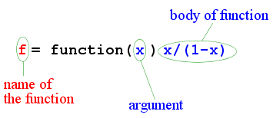
Functions in R
>g = function(x,y) (x+2*y)/3
>g(1,2)
>g(2,1)

Slide 55
Any question?
You may post your question(s) at the “Discussion Forum” maintained in the course Web page!

Slide 56
Just a minute to mark your attendance

